Slide 1

Scope

Slide 2

Thinking about scope - One way mirror

Slide 3


Slide 4


Slide 5


Slide 6
function parent(){
const hobby = "basketball";
const partner = "Jill";
function child(){
const hobby = "base jumping";
const bankBalance = "100";
}
}

Slide 7

function parent(){
const hobby = "basketball";
const partner = "Jill";
function child(){
const hobby = "base jumping";
const bankBalance = "100";
}
}

Slide 8

function parent(){
const hobby = "basketball";
const partner = "Jill";
function child(){
const hobby = "base jumping";
const bankBalance = "100";
}
}

Slide 9

Functional scope and block scope

Slide 10
Function scope variables – declared with “var”
Only available inside the function they are created
Block is ignored – e.g. variable created in conditional/loop statement
function scope(){
for (let i=0; i<5; i++){
console.log(i);
}
console.log(i); // i=5
}

Slide 11
Benefits of let and const
Block scope – code enclosed by curly braces
function scope(){
for (var i=0; i<5; i++){
console.log(i);
}
console.log(i); // undefined error
}

Slide 12
Summary
var – function scope – scope within the function
let and const – block scope – scope within curly brackets

Slide 13

Value and reference: the same one or a copy

Slide 14
JavaScript primitive values types
Numbers
Strings
Booleans
Undefined

Slide 15
Passing primitive to function
Function calls pass value
Passed by
value
You pass a copy to a function

Slide 16
Object types
Objects
Arrays
Dates
Functions
Almost anything made with “new” keyboard – not used in course

Slide 17
Objects are passed by reference
Objects are never copied
Passed
by
reference
You pass a reference to a function

Slide 18
Within the object
Primitive and object behavior hold

Slide 19
<end/>

Slide 20

Language for communication

Slide 21
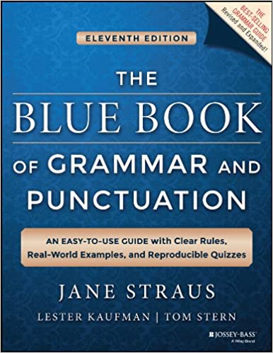
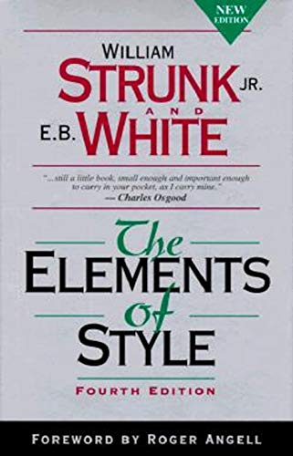
Do you need to know all of the rules?

